Slide 1
Design Patterns in .Net
Real world use of design patterns in .Net applications
Notes:
Welkom blablabla

Slide 2
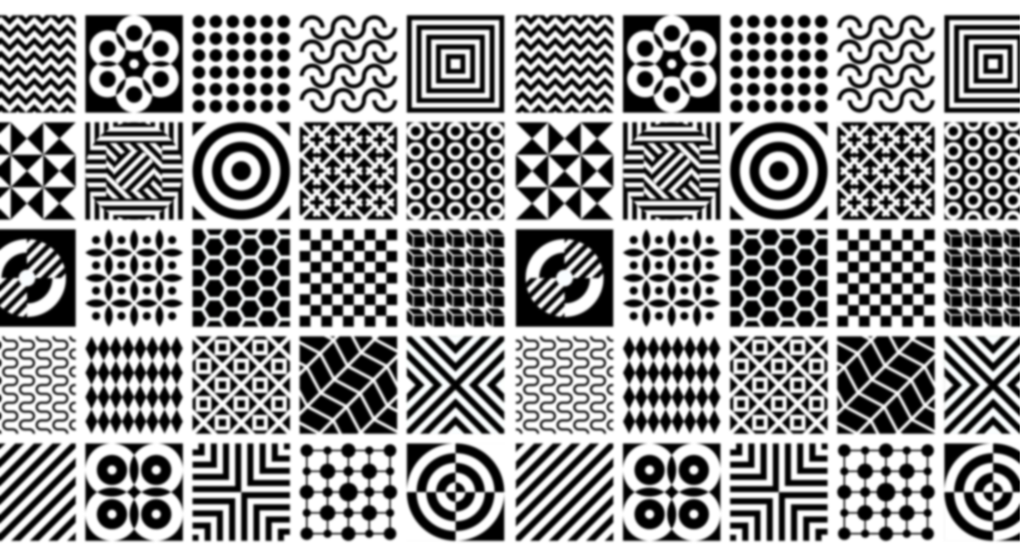
Notes:
Ladies and gentlemen, imagine a world where every architectural marvel, from the towering skyscrapers of New York to the serene temples of Kyoto, follows a set of universal principles. These principles, known as design patterns, provide architects with a language of solutions to recurring challenges in their craft. But what if I told you that this concept didn't just stay within the realm of buildings and bridges? What if it transcended into the very codes and algorithms that power our digital world?

Slide 3

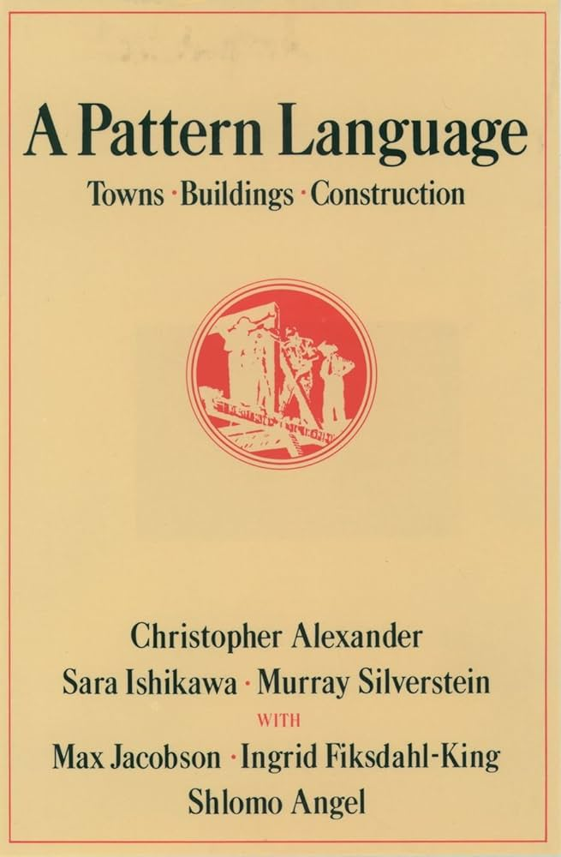
Notes:
In 1977, Christopher Alexander, an architect with a keen eye for patterns, introduced a revolutionary idea in his book 'A Pattern Language.' He proposed a language centered around entities called patterns—timeless solutions to architectural problems found across different cultures. These patterns weren't just bricks and mortar; they were the building blocks of universal design thinking.

Slide 4
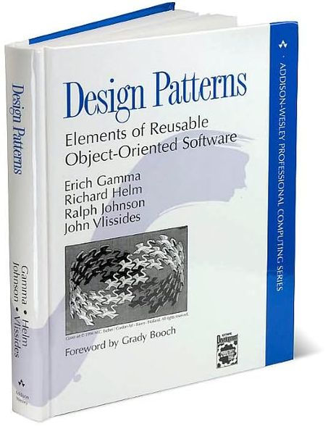
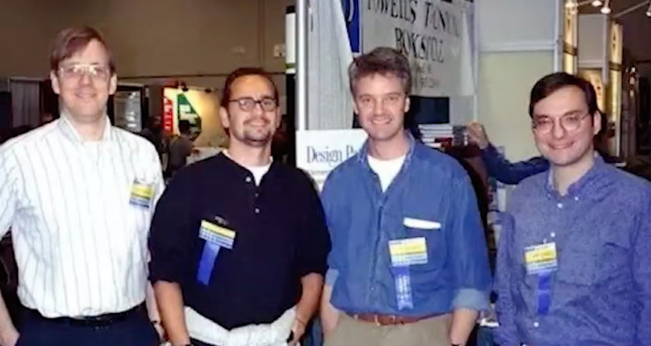
Notes:
Fast forward to 1995, a landmark year for software engineering. Four visionaries—Erich Gamma, Richard Helm, Ralph Johnson, and John Vlissides—crafted a masterpiece: 'Design Patterns: Elements of Reusable Object-Oriented Software.' This book, also known as the 'Gang of Four' (GoF) bible, brought the concept of design patterns into the digital age. Drawing inspiration from Alexander's work in architecture, they observed how software development teams faced similar challenges. Just as a blueprint guides an architect, these design patterns became the blueprint for software engineers, guiding them through the complexities of code.

Slide 5
What is a design pattern?
Notes:
But what exactly is a design pattern? Imagine it as a roadmap, not for physical structures, but for the structures of code itself. These are tried-and-tested solutions to common programming problems, offering a clear path through the maze of software development. From object composition to class structure, design patterns in languages like C# provide a framework for developers to create more readable, maintainable, and efficient code.

Slide 6



Kjell Coppin
Notes:
Hello, I'm Kjell Coppin, a passionate software engineer with a focus on .NET development. Today, in this TED talk, I aim to empower fellow developers by sharing insights on writing cleaner, more efficient code trough design patterns.

Slide 7
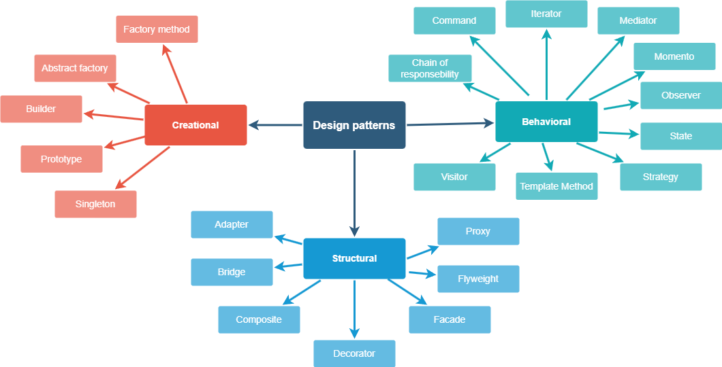
Notes:
In the famous book written by the Gang of four, 3 types of design patterns are talked about.
Creational Patterns: These patterns focus on the process of object creation, providing mechanisms for creating objects in a manner suitable for a given situation. Examples include Factory Method, Abstract Factory, Singleton, Builder, and Prototype patterns.
Structural Patterns: Structural patterns deal with the composition of classes or objects to form larger structures. They help ensure that if one part of a system changes, the entire system doesn't need to do so. Examples include Adapter, Decorator, Proxy, Composite, and Facade patterns.
Behavioral Patterns: Behavioral patterns are concerned with communication between objects, focusing on how objects distribute responsibilities and duties among themselves. Examples include Observer, Strategy, Command, Iterator, and State patterns.

Slide 8

Real world usage
Notes:
Since i did my internship at Bestmix i will use their codebase to show you how some of these design patterns are used in real production software.
Bestmix recipe management is a software that allows users to accurately manage recipes and generate product specifications.

Slide 9
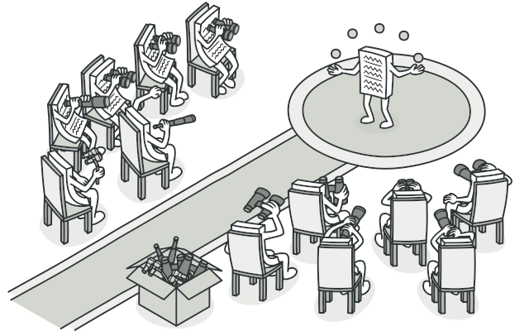
Observer pattern
Figure 1
Notes:
An interesting behavioural pattern is the Observer pattern.
Observer lets you define a subscription mechanism to notify multiple objects about any events that happen to the object they’re observing.
In Bestmix there are many entities such as recipes, products, parameters and much more. These entities can be created and edited, which means they need to be validated as well. An entity with invalid data, such as empty mandatory fields should not be saved to the database. For this reason there is a validator class

Slide 10
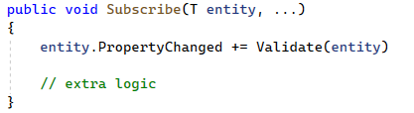
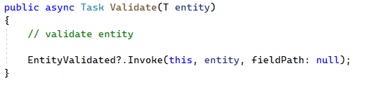
Validator.cs
Notes:
To do this, the validator class has an event and a delegate. In C#, the Observer pattern is implemented using events and delegates, which are built-in language features. Events allow an object to notify other objects when something of interest occurs. Delegates are used to define the signature of the event handler method. So entities can subscribe to the validator’s EntityValidatedEvent to get notified when they have been validated.
Next the validator also has a Subscribe method so that the validator itself can subscribe to entities.
Entity.PropertyChanged is an event that variables have in C# by default.
So when the validator is subscribed to an entity, it will validate this entity automatically with the validate method since the validate method is the event handler for entity.propertyChanged.
And after validating, the EnittyValidated event is invoked, notifying the subscribed entity.

Slide 11
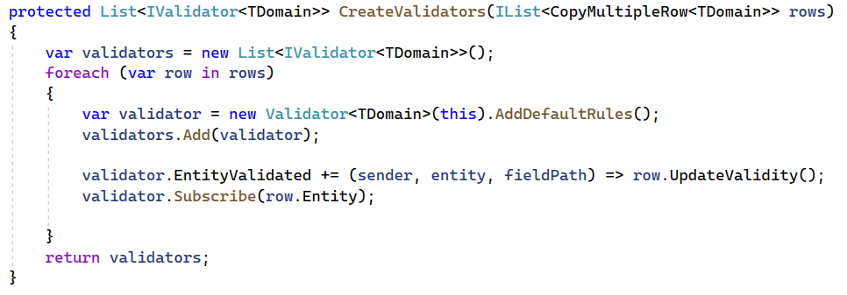
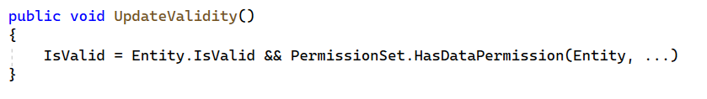
ChangeMultipleEntitiesViewModel
Notes:
One place where this validator is used is in the ChangeMultipleRecipesViewmodel. This viewmodel shows a grid with multiple entities, which you can edit in the grid itself.
In this viewmodel, a validator gets added to each row (with each row representing an entity)
you can see that first the row subscribes to its validator and assigns UpdateValidity() as event handler. Then the validator subscribes to the row’s entity using its Subscribe method.
All of this means that When an entity is changed in the ChangeMultipleRecipesViewModel, the validator automatically validates it.
And when it is done validating, the row of this entity will automatically update it’s isValidated property and potentially block it from being saved to the Db.

Slide 13
Thanks for your attention ofzo
Figure 1: https://refactoring.guru/design-patterns/observer

